Slide 1


Data
Analysis

Slide 2


Today's agenda
Project recap
Problem
The Analytics team
Process
Insights
Summary

Slide 3

Social Buzz is a fast growing technology unicorn that need to adapt quickly to it's global scale. Accenture has begun a 3 month POC focusing on these tasks:
An audit of Social Buzz's big data practice
Recommendations for a successful IPO
Analysis to find Social Buzz's top 5 most popular categories of content
Project Recap

Slide 4




o
Problem
Over 10000 posts per day
36,50,000 pieces of content per year!
But how to capitalize on it when there is so much?
Analysis to find Social Buzz's top 5 most popular categories of content

Slide 5



You
Data Analyst
The Analytics team
MARCUS ROMPTON
Senior Principal
ANDREW FLEMING
Chief Technical Architect

Slide 6
Process
1
Data Understanding
2
Data Cleaning
Data Modelling
3
4
Data Analysis
5
Uncover insights

Slide 7

Insights
16
1897
JANUARY
UNIQUE
CATEGORIES
REACTIONS TO "ANIMAL" POSTS
MONTH WITH
MOST POSTS

Slide 8
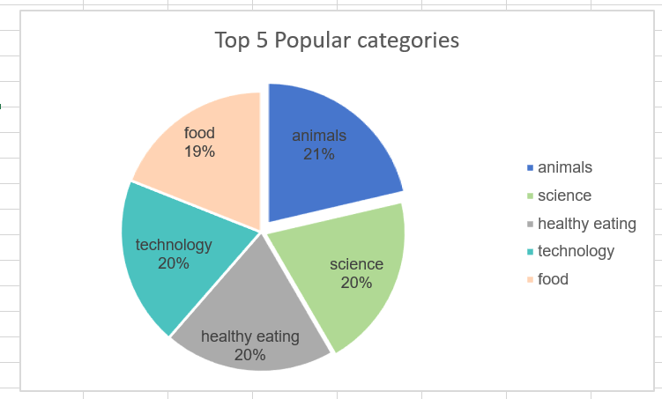

Slide 9
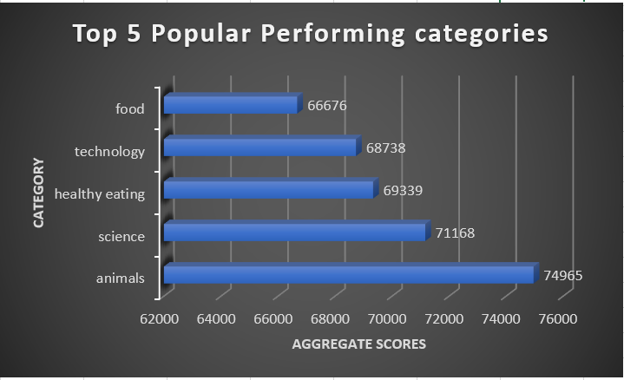

Slide 10


Summary

Slide 11
Thank you!
ANY QUESTIONS?

